Slide 1




CNN MODEL ON MNIST DATASET FOR WRITTEN DIGIT CLASSIFICATIAON
CNN
Building a Convolutional Neural Network
MNIST
Modified National Institute of Standards and Technology
MODEL ON
Handwritten Digit Classification on the MNIST Dataset

Slide 2
What is the Project on ?
Handwritten Digit Recognition is the process of digitizing human handwritten digit images. It is a difficult task for the machine because handwritten digits are not perfect and can be made with a variety of flavors. In order to address this issue, we created convolutional neural network (CNN, or ConvNet) is a Deep Learning algorithm that can take in an input image, It is used to analyze visual imagery and produce output as text about what number is present in that image.
0 1 2 3 4 5 6 7 8 9

Slide 3
Handwritten Digit Classification
Handwritten digit classification is a fundamental task in the field of computer vision and machine learning. It involves developing algorithms or models to automatically recognize and categorize handwritten digits into their respective numerical representations, typically from 0 to 9. The handwritten digit classification is the ability of the model to recognize the human handwritten digits. The handwritten digits may have different size and orientation since it differs from person to person in writing style. Hence it is a hard task for machines to recognize handwritten digits. Handwritten digit classification is the solution to this problem which uses the image of a digit and recognizes the digit present in the image.

Slide 4
MNIST Handwritten Digit dataset
The MNIST (Modified National Institute of Standards and Technology) Handwritten Digit dataset is one of the most widely used benchmark datasets in the field of machine learning and computer vision. It serves as a fundamental resource for testing and developing various image classification and machine learning algorithms, particularly for handwritten digit recognition.
Contents: The MNIST dataset consists of 70,000 grayscale images of handwritten digits from 0 to 9. These images are divided into two main subsets:
Training Set: This set contains 60,000 images, which are typically used for training machine learning models.
Testing Set: The remaining 10,000 images are included in the testing set to evaluate the model's performance and generalization ability.

Slide 5
Image Characteristics: Each image in the MNIST dataset is a 28x28-pixel square grayscale image. The digits are centered within these images, and the backgrounds are relatively consistent, making the dataset suitable for digit recognition tasks.
Labeling: Every image is associated with a corresponding label, which indicates the digit that the image represents. The labels are integers from 0 to 9.
Applications: The MNIST dataset has been used as a benchmark for evaluating and comparing the performance of various machine learning and deep learning models, especially in the context of image classification and digit recognition. It's a common starting point for those learning about neural networks and computer vision.
Usage: MNIST has been instrumental in the development and testing of convolutional neural networks (CNNs), a type of deep learning architecture that has achieved remarkable accuracy in digit recognition tasks.

Slide 6
Prerequisites for the Project
For developing this project the user should have the system with Python 3 software installed.
Then install the necessary libraries required for this project,
They are:
Numpy
Matplotlib
CV2
TensorFlow
Keras

Slide 7
Steps to Build the Model
Steps to Build the Model
The process of constructing a deep learning model for MNIST handwritten digit classification can be summarized in the following steps:
1. Begin by Importing necessary Libraries.
2. Load the Dataset containing the handwritten digit images.
3. Prepare the images through various Image Processing steps.
4. Construct the Neural Network Architecture.
5. Train the Model using the prepared data.
6. Assess the model's performance and results by Conducting Evaluations.

Slide 8
Loading MNIST DataSet
We are aware that each image in the collection is pre-aligned, meaning it only contains a single hand-drawn digit. As a result, all of the photos have the same size (2828 pixels), and we are also aware that they are all grayscale. As a result, we may simply load the photos. The Keras package contains the MNIST dataset. The mnist data can be imported from keras.datasets.
To load the dataset of MNIST,
It is loaded from the googleapis.com
(X_train, Y_train), (X_test, Y_test) = mnist.load_data()
https://storage.googleapis.com/tensorflow/tf-keras-datasets/mnist.npz

Slide 9
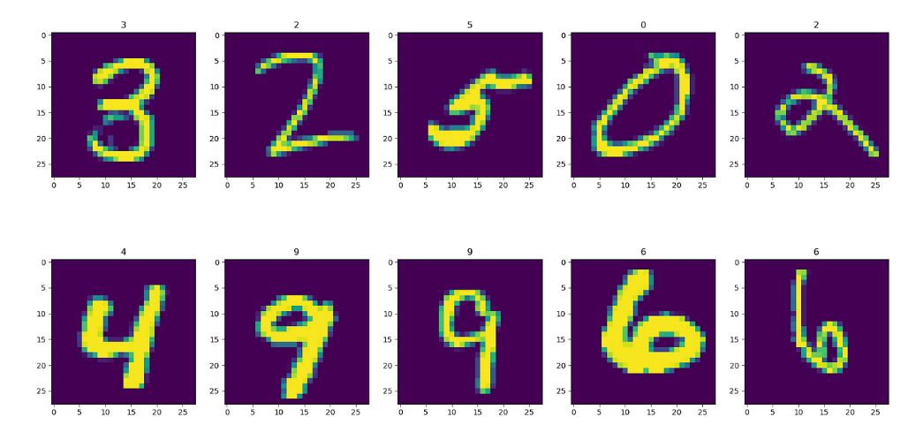
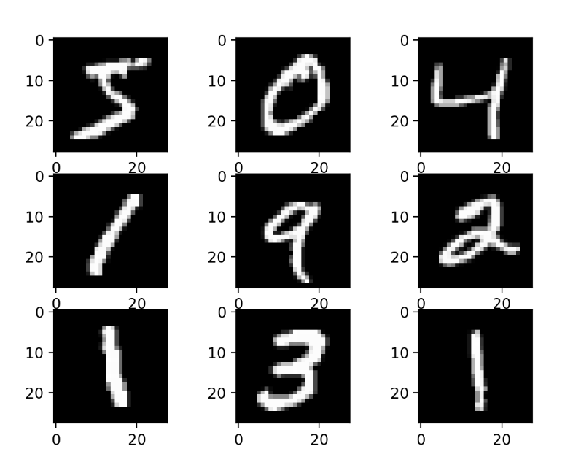
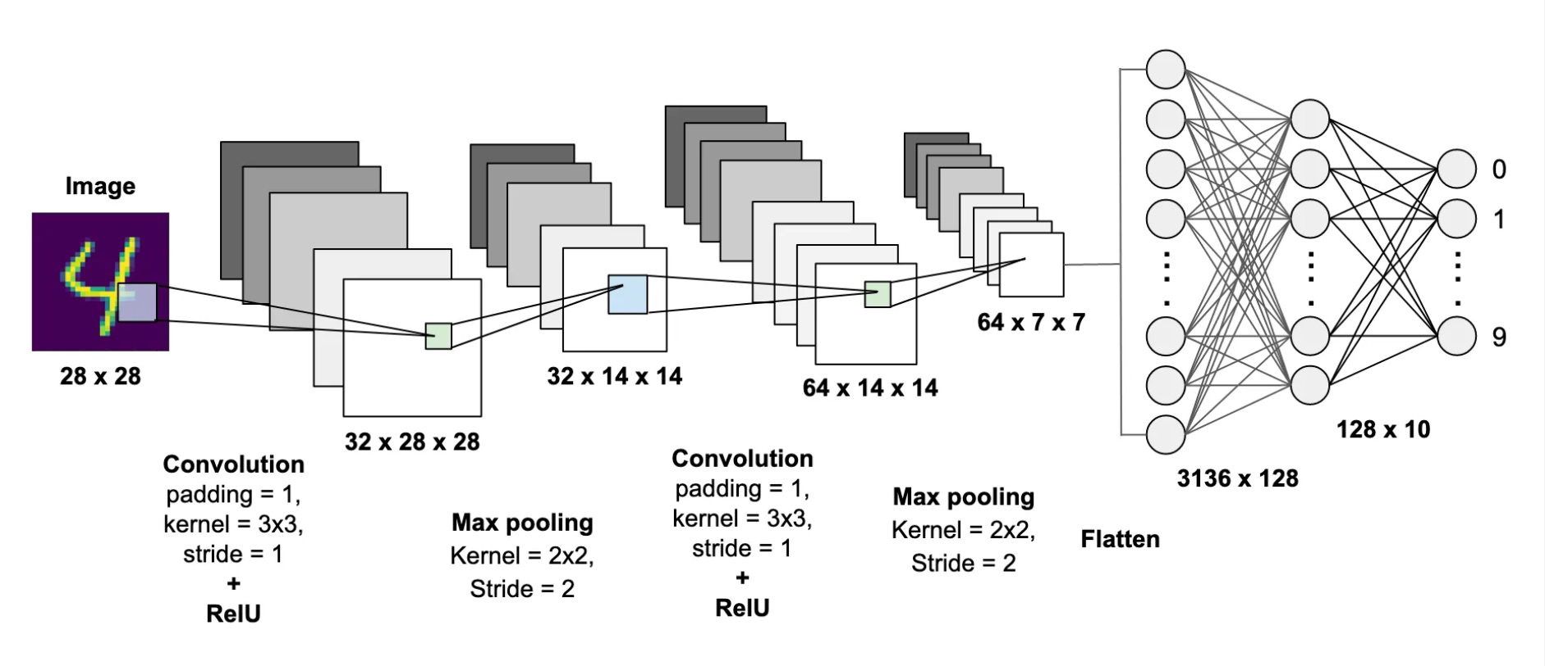
Deep CNN
Computer Vision

Slide 10
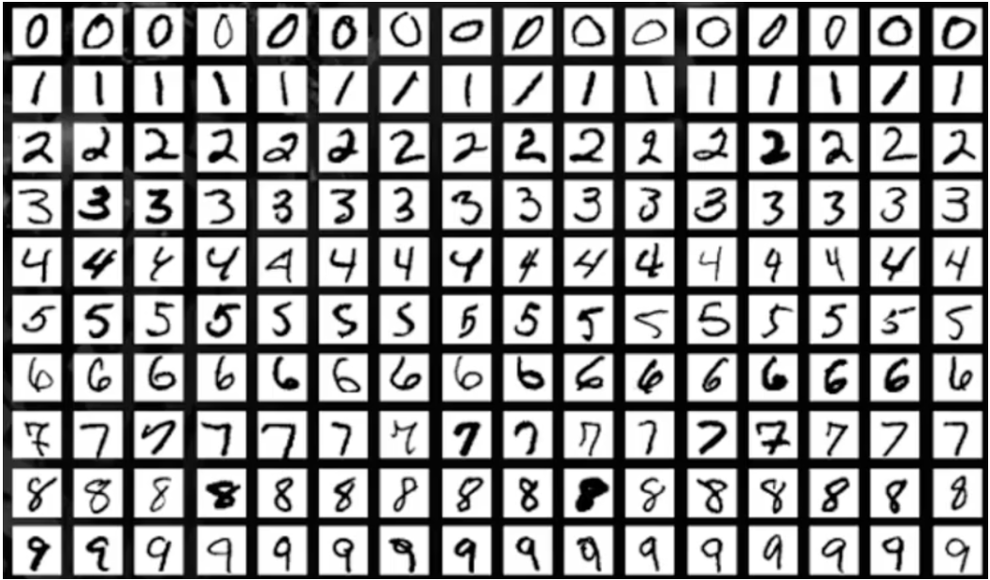
Image Processing
In image processing, the data is transformed and scaled to fit inside a predetermined scale.
# Scaling the values X_train = X_train/255 X_test = X_test/255

Slide 11
Building the Neural Network
Using Keras, we'll build the simplest straight forward single-layer neural network possible.After the model has been developed, it must be assembled and fitted. The model will scan the dataset and recognize the relationships while it is being fitted. The technique will be repeated as many times as necessary for learning.
Flatten
Dense
Conv2D
MaxPooling
Dropout

Slide 12
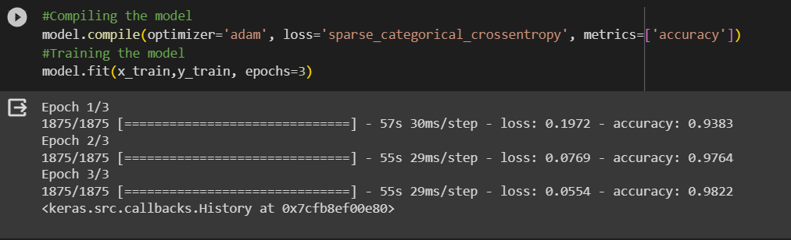
Training the Model
In our case, we have 10 epochs defined. The model will develop during the process and make errors. There is a penalty for each incorrect prediction the model produces, and this penalty is reflected in the loss value for each epoch. In other words, at the conclusion of the previous epoch, the model should provide as little loss and as much precision as possible.
We can see that the training data accuracy for our model is 98.2%

Slide 13
Evaluating the Model
Model evaluation is the process of using different evaluation metrics to understand a machine learning model's performance, as well as its strengths and weaknesses. Model evaluation is important to assess the efficacy of a model during initial research phases, and it also plays a role in model monitoring.
#Printing the Accuracy level
loss, accuracy= model.evaluate(x_test, y_test)
accuracy*100

Slide 14
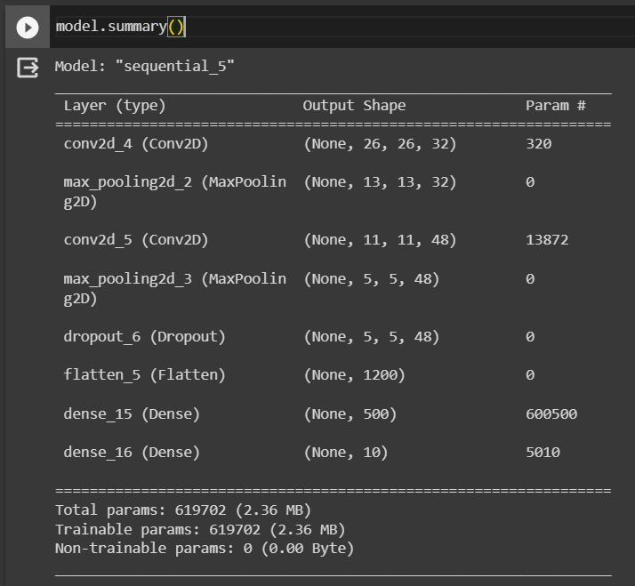
This is the Summary of the model
In this manner, we may develop our CNN-based MNIST Digit Classification Model.
Building neural networks is more important since it influences the levels on which accuracy depends. Therefore, you should pursue every avenue to obtain the greatest result, pre section, or number identification from a handwritten image. At last create GUI or write image classification for input image and output the prediction

Slide 15
THANK YOU
V S S L DEEPAK JANAPA Acmegrade LMS Id: ACG2310101308041

